Slide 1
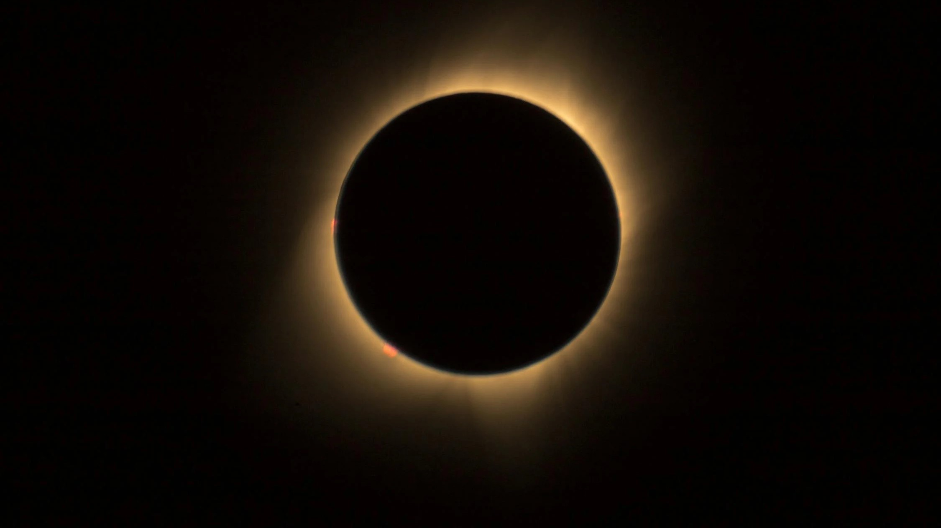
Reinforcement Learning
Wednesday, April 10, 2024
Steve O’Hearn

Slide 2
Reinforcement Learning
Agent
These terms are central to defining the basic concepts of reinforcement learning.
Reward
Action
State
Action Space
Environment

Slide 3
Reinforcement Learning
Agent
A decision maker that chooses an action to change an environment’s state to gain a reward.
Reward
Action
State
Action Space
Environment

Slide 4
Reinforcement Learning
Agent
Reward
An action is performed within an environment to change it from one state to another state.
Action
State
Action Space
Environment

Slide 5
Reinforcement Learning
Agent
All possible actions that an agent may be able to take at some point, perhaps not now.
Reward
Action
State
Action Space
Environment

Slide 6
Reinforcement Learning
Agent
Reward
The scope that encompasses all actions and states.
Action
State
Action Space
Environment

Slide 7
Reinforcement Learning
Agent
Reward
The present configuration of the environment.
Action
State
Action Space
Environment

Slide 8
Reinforcement Learning
Agent
Reward
Something of value to the agent provided by the present state.
Action
State
Action Space
Environment

Slide 9
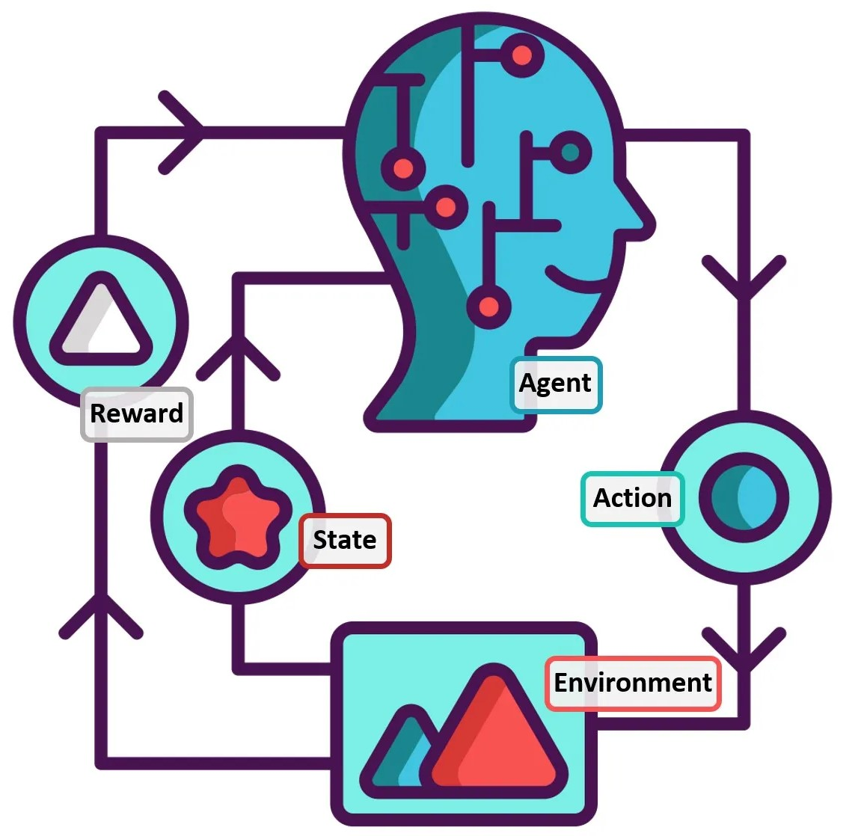
RL: Overview
Agent chooses an action from an “action space”
The action changes the environment from one state to another state
Each action may or may not result in a reward
Objective: find an action series to optimize reward(s)
ACTION SPACE
Reinforcement Learning: A Review of Historic, Modern, and Historic Developments … | Chris Mahoney | Towards Data Science

Slide 10
RL: The Quantum Leap Forward
For years, researchers worked to create a chess algorithm
Objective: defeat a human chess master
Strategy: work with chess master to capture top strategies, implement in code
Results: slow and mixed
THE QUANTUM LEAP FORWARD: Researchers:
STOPPED TALKING TO HUMANS
Built a complete chess simulator
Designed and algorithm to learn from playing the simulator

Slide 11

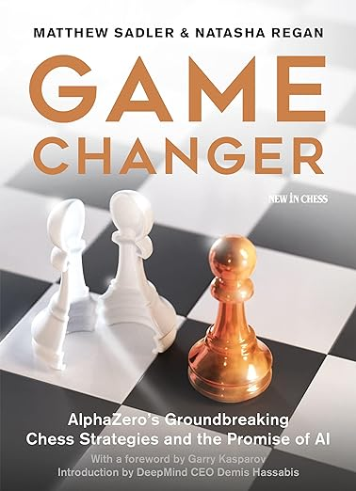
Garry Kasparov - Russian Chess Grandmaster
World Chess Champion 1985-2000
Highest Rated Chess Player in History (until 2013)
December 2018

Slide 12
“AlphaZero doesn’t need to laboriously analyze millions of human games when it can play more games against itself in a few hours than have ever been recorded in human history.”
Garry Kasparov - Russian Chess Grandmaster
World Chess Champion 1985-2000
Highest Rated Chess Player in History (until 2013)
December 2018

Slide 13
“AlphaZero doesn’t need to laboriously analyze millions of human games when it can play more games against itself in a few hours than have ever been recorded in human history.”
Garry Kasparov - Russian Chess Grandmaster
World Chess Champion 1985-2000
Highest Rated Chess Player in History (until 2013)
“Google’s self-driving cars have recorded millions of miles on the road but billions of miles virtually.”
December 2018

Slide 14
“AlphaZero doesn’t need to laboriously analyze millions of human games when it can play more games against itself in a few hours than have ever been recorded in human history.”
Garry Kasparov - Russian Chess Grandmaster
World Chess Champion 1985-2000
Highest Rated Chess Player in History (until 2013)
“Google’s self-driving cars have recorded millions of miles on the road but billions of miles virtually.”
December 2018
“Perhaps the most difficult prejudice to overcome: our demand that our machines be completely free of error instead of merely superior.”

Slide 15
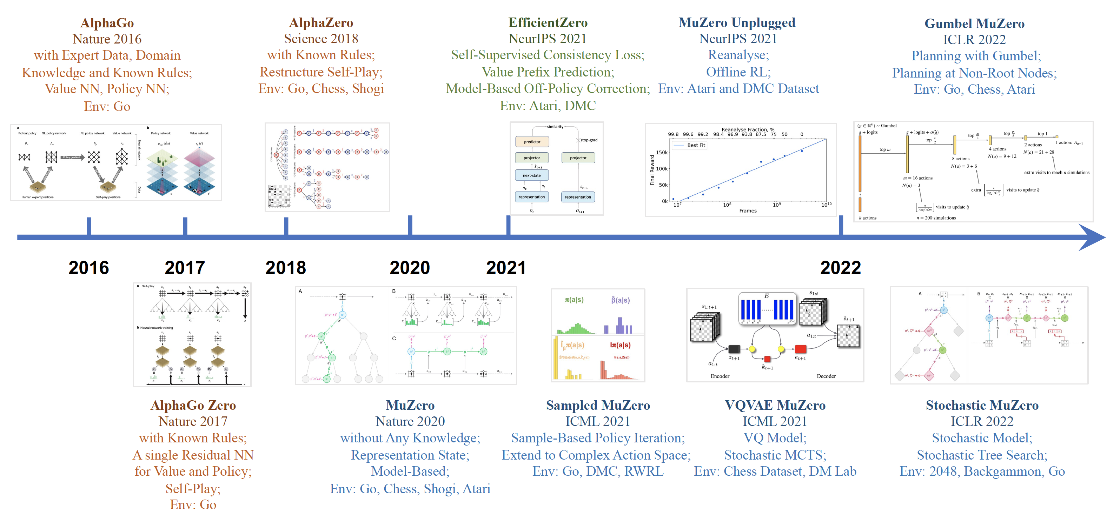
RL: Algorithm History
https://github.com/opendilab/LightZero/blob/main/assets/mcts_rl_evolution_overview.png

Slide 16
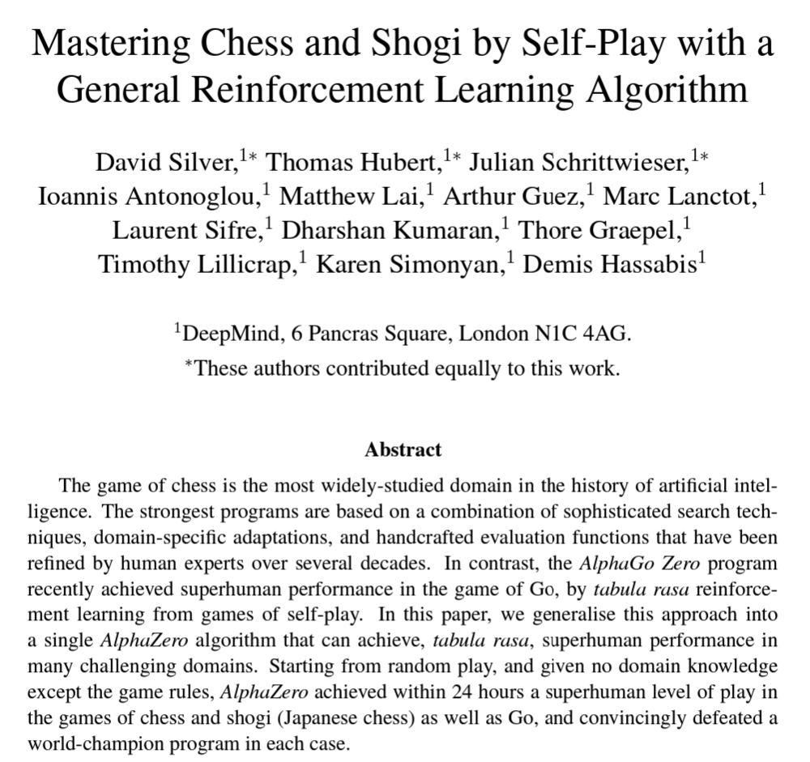
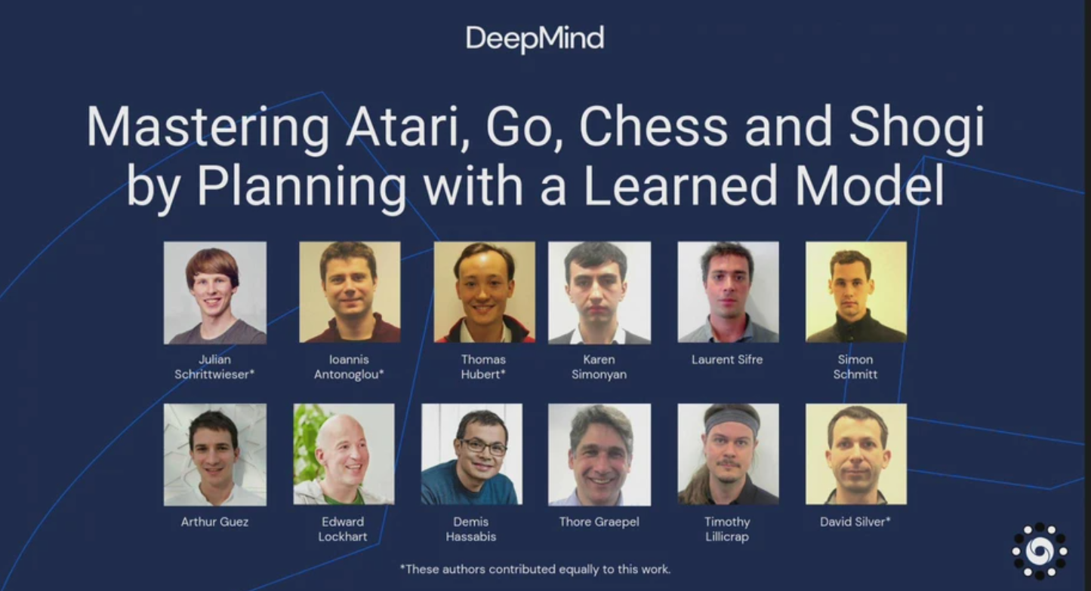
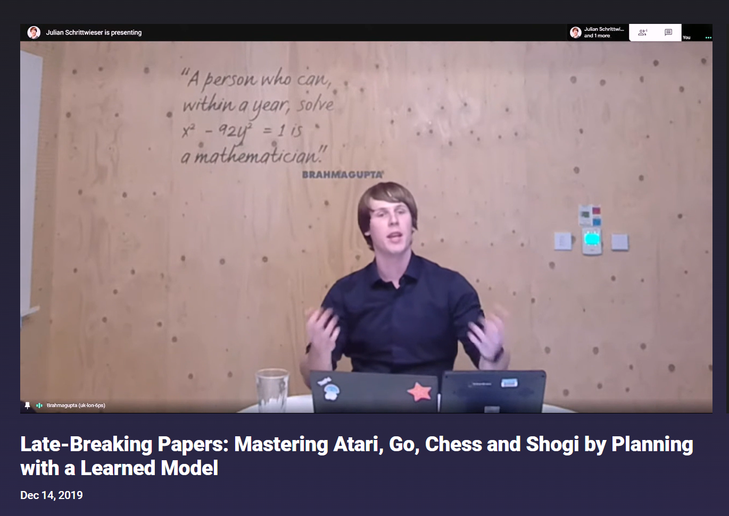
https://slideslive.com/38922736/latebreaking-papers-mastering-atari-go-chess-and-shogi-by-planning-with-a-learned-model

Slide 17
RL: Common Scenarios
Two player: agent vs. simulated player (dumb or expert)
Checkers, Chess, Go
Win/Lose
Objective: Accumulation of points vs. winner-take-all
One player: agent vs. environment
Atari – classic arcade games
Lose only (no win)
Objective: Accumulation of points before inevitable lose
Environments
Pre-defined vs. dynamically defined

Slide 18
Action space example: MuZero w/Tic Tac Toe
Action # | Description
1 | Place an “X” in space 1
2 | Place an “X” in space 2
3 | Place an “X” in space 3
4 | Place an “X” in space 4
5 | Place an “X” in space 5
6 | Place an “X” in space 6
7 | Place an “X” in space 7
8 | Place an “X” in space 8
9 | Place an “X” in space 9
1
2
3
X
4
5
6
1
7
8
9

Slide 19
Action space example: MuZero w/Tic Tac Toe
Action # | Description
1 | Place an “X” in space 1
2 | Place an “X” in space 2
3 | Place an “X” in space 3
4 | Place an “X” in space 4
5 | Place an “X” in space 5
6 | Place an “X” in space 6
7 | Place an “X” in space 7
8 | Place an “X” in space 8
9 | Place an “X” in space 9
1
2
3
X
4
5
6
1
Any reward? No.
7
8
9

Slide 20
Action space example: Tic Tac Toe
Action # | Description
1 | Place an “X” in space 1
2 | Place an “X” in space 2
3 | Place an “X” in space 3
4 | Place an “X” in space 4
5 | Place an “X” in space 5
6 | Place an “X” in space 6
7 | Place an “X” in space 7
8 | Place an “X” in space 8
9 | Place an “X” in space 9
1
2
3
X
4
5
6
2
X
7
8
9
O

Slide 21
Action space example: Tic Tac Toe
Action # | Description
1 | Place an “X” in space 1
2 | Place an “X” in space 2
3 | Place an “X” in space 3
4 | Place an “X” in space 4
5 | Place an “X” in space 5
6 | Place an “X” in space 6
7 | Place an “X” in space 7
8 | Place an “X” in space 8
9 | Place an “X” in space 9
1
2
3
X
4
5
6
2
X
Any reward? No.
7
8
9
O

Slide 22
Action space example: Tic Tac Toe
Action # | Description
1 | Place an “X” in space 1
2 | Place an “X” in space 2
3 | Place an “X” in space 3
4 | Place an “X” in space 4
5 | Place an “X” in space 5
6 | Place an “X” in space 6
7 | Place an “X” in space 7
8 | Place an “X” in space 8
9 | Place an “X” in space 9
1
2
3
X
X
4
5
6
3
X
7
8
O
9
O

Slide 23
Action space example: Tic Tac Toe
Action # | Description
1 | Place an “X” in space 1
2 | Place an “X” in space 2
3 | Place an “X” in space 3
4 | Place an “X” in space 4
5 | Place an “X” in space 5
6 | Place an “X” in space 6
7 | Place an “X” in space 7
8 | Place an “X” in space 8
9 | Place an “X” in space 9
1
2
3
X
X
4
5
6
3
X
Any reward? No.
7
8
O
9
O

Slide 24
RL Under the Hood
Environment
MuZero
Algorithm
API
Game
Simulator
Training Configuration
Action Space Management

Slide 25
RL Under the Hood: Action Space
All possible actions
Currently legal actions
One game’s history of action

Slide 26
RL Under the Hood: Common Techniques
Monte Carlo Tree Search
Neural Networks
Markov Decision Process

Slide 27
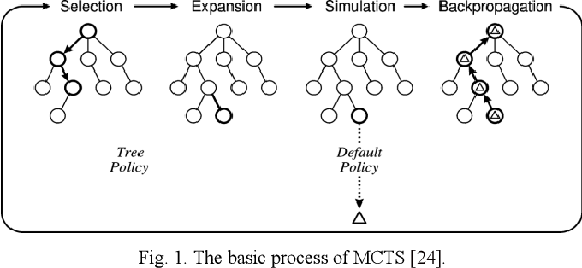
RL Under the Hood: Common Techniques
Monte Carlo Tree Search
Neural Networks
Markov Decision Process

Slide 28
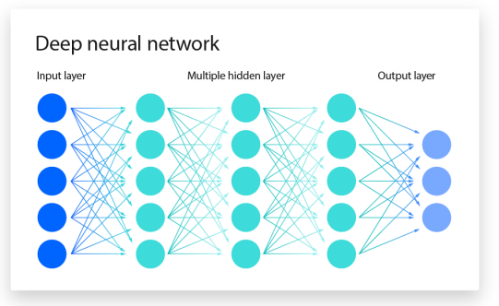
RL Under the Hood: Common Techniques
Monte Carlo Tree Search
Neural Networks
Markov Decision Process
https://www.ibm.com/topics/neural-networks

Slide 29
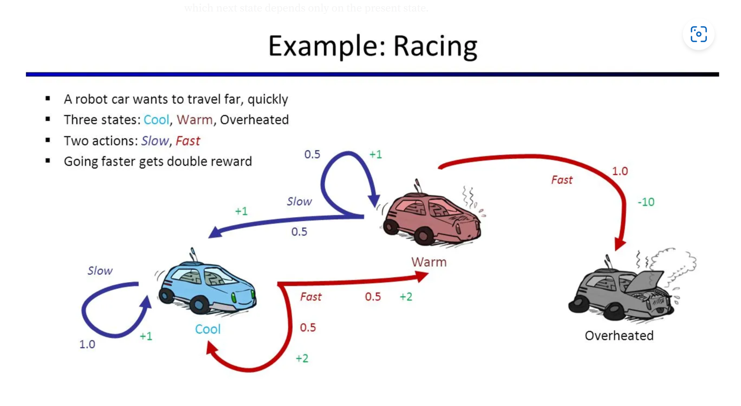
RL Under the Hood: Common Techniques
Monte Carlo Tree Search
Neural Networks
Markov Decision Process
https://sanchittanwar75.medium.com/markov-chains-and-markov-decision-process-e91cda7fa8f2

Slide 30
MuZero: How to work with it
Define the real world “agent” and a quantified “reward”
Interim rewards are ok – and good
Consider “negative rewards”
Specify win and/or lose autonomous recognition
Define the “action space”
Uniquely identify each action
Create (code) a simulator for your real world scenario
Action space can be pre-defined or dynamic
Configure hyperparameters
Integrate into the MuZero API
Algorithm only needs the unique action number, and quantified reward results (points, win, lose, draw – negatives are OK)

Slide 31
RL: Getting past board games
Board games, arcade games are CLOSED SYSTEMS.
All rules are known.
All possibilities can be pre-coded.
No new information can be introduced, nor needs to be.
RL can be applied beyond this limitation.
Dynamically created action spaces.
Action Space scope definition: training process, multiple games
Individual actions: uniquely identified (in scope) and defined.

Slide 32

Action space example: Autonomous Driving
Action # | Description
1 | Decrease speed by 5 mph
2 | Increase speed by 5 mph
3 | Turn left
4 | Turn right
5 | Continue status quo
Reward: Reach destination
Negative reward: Crash

Slide 33
RL Under the Hood
Real
Environment?
Simulated
Environment?
OR
MuZero
Algorithm
API
“Game”
Simulator
Training Configuration
Action Space Management

Slide 34
RL Under the Hood
Real
Environment?
Simulated
Environment?
OR
MuZero
Algorithm
API
“Game”
Simulator
Monte Carlo Tree Search, Neural Networks, Markov Decision Process
Python libraries: torch, numpy, nevergrad
Training Configuration
Action Space Management

Slide 35
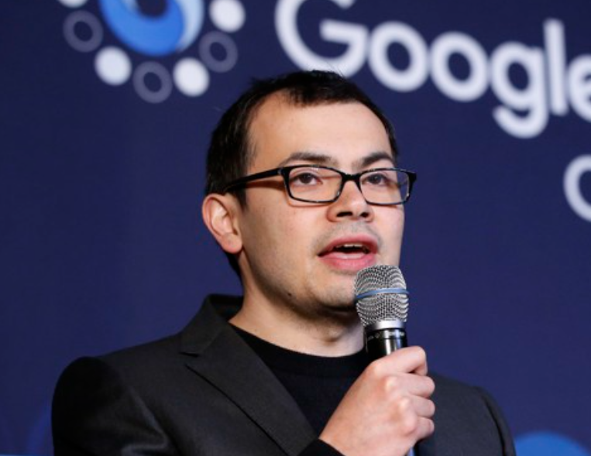
RL: Beyond board games
Robotics
Autonomous Driving
Energy storage operations
Drug discovery
AlphaFold
Google’s Isomorphic Labs
Demis Hassabis

Slide 36
Demis Hassabis

Slide 37

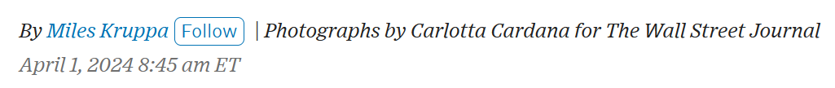
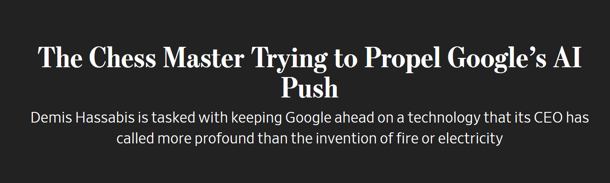
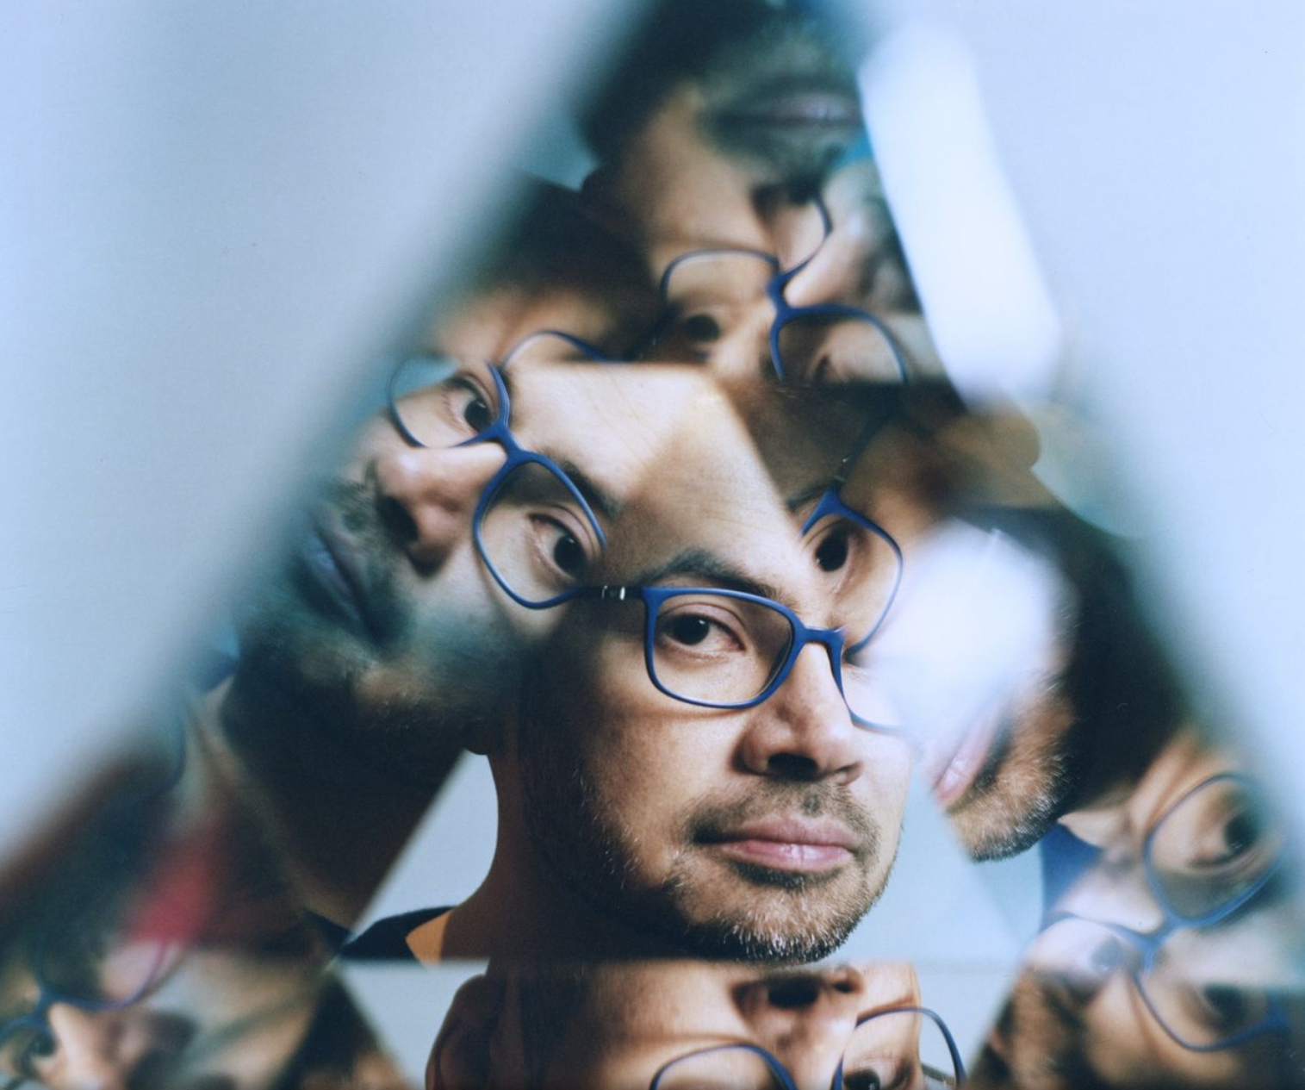
RL: Next?
Demis Hassabis

Slide 38
Questions?
steve@
nylatechnologysolutions.com
Steve O’Hearn
Reinforcement Learning

